Slide 1
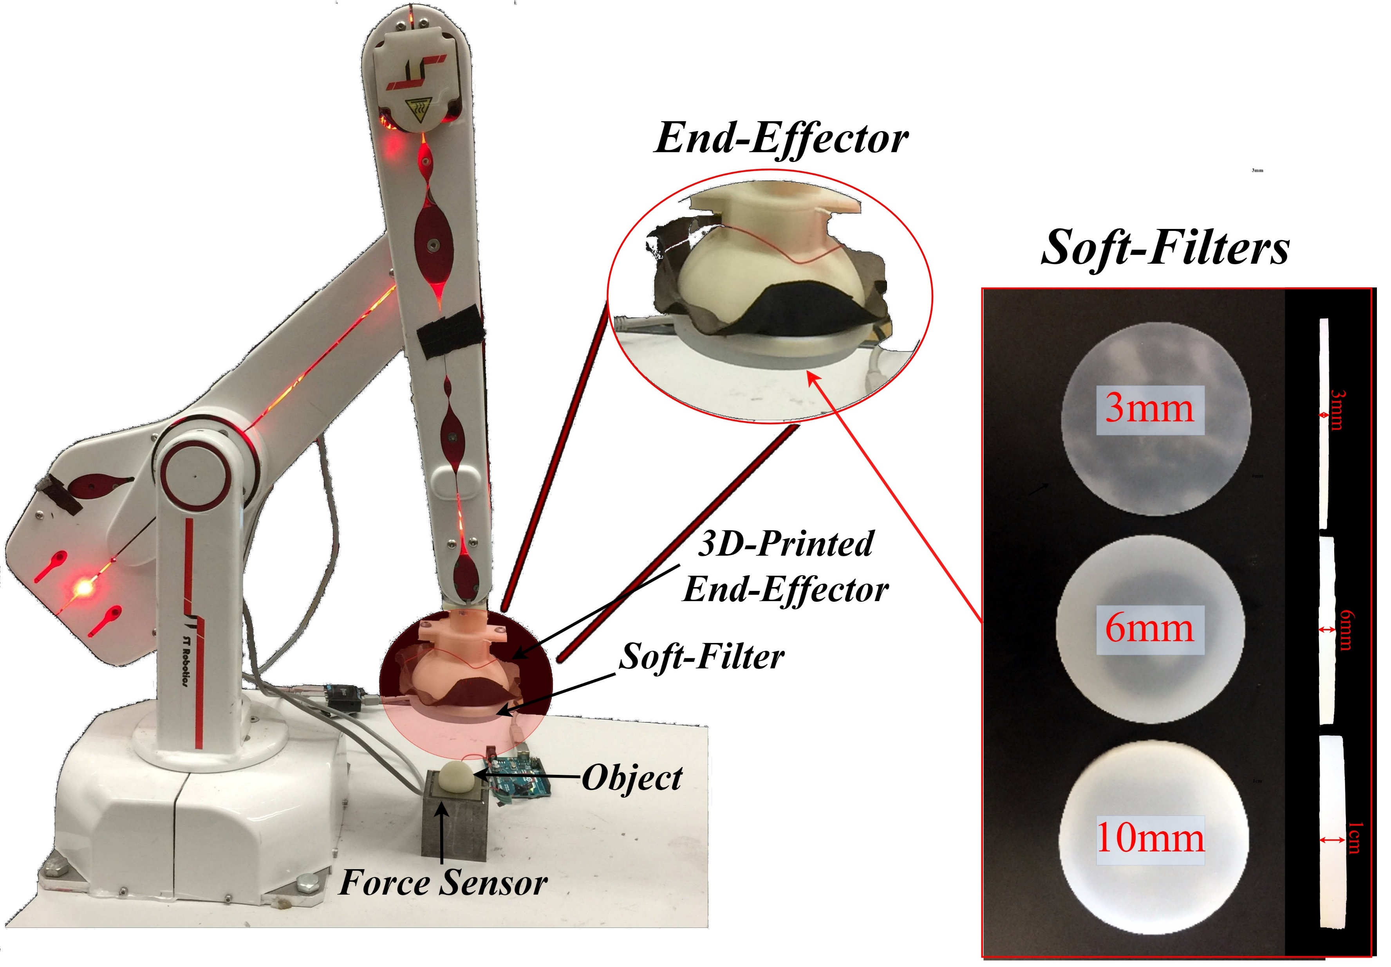
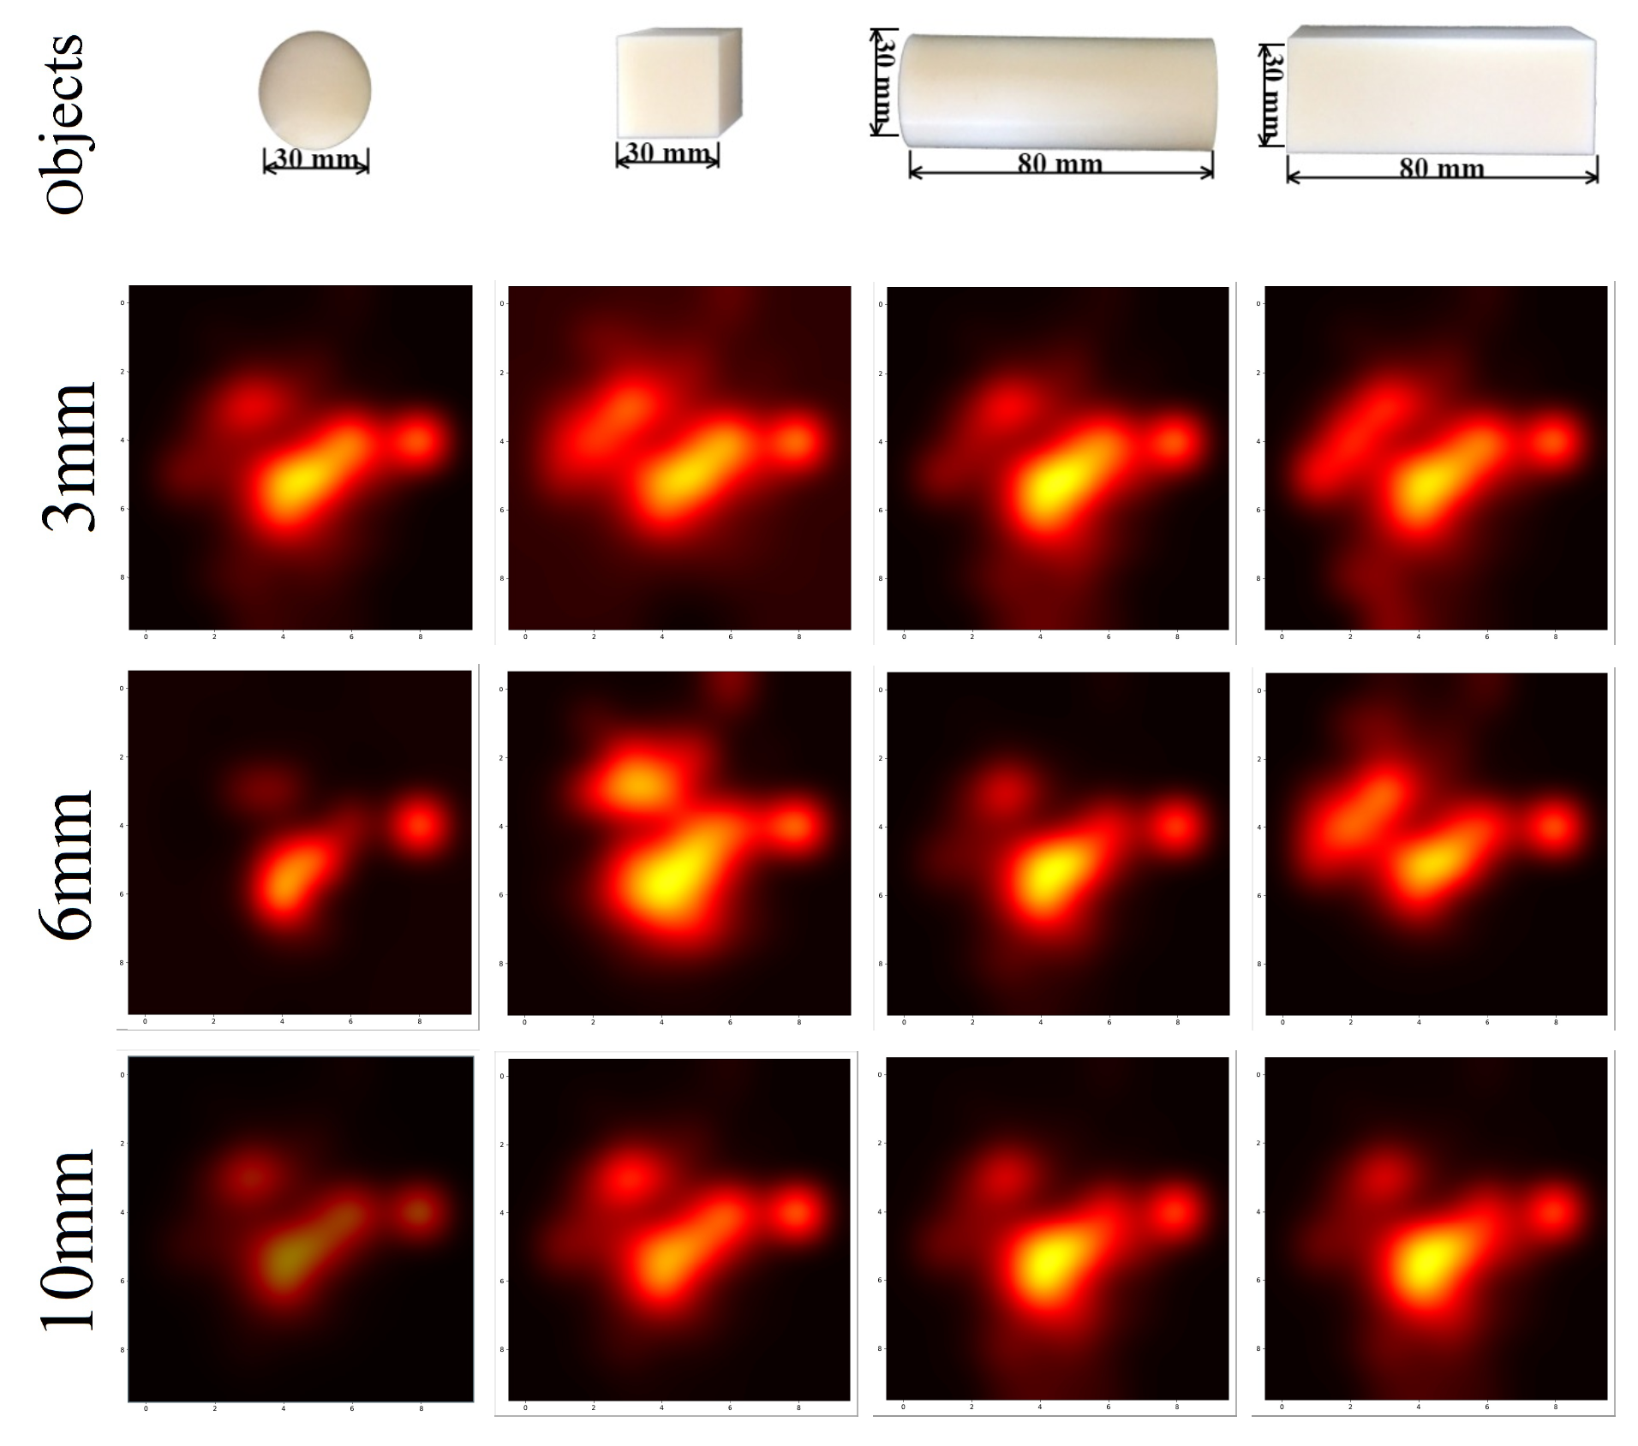


Soft Morphological Processing of Tactile Stimuli for Autonomous Category Formation
Luca Scimeca, Perla Maiolino, Fumiya Iida
ls769@cam.ac.uk, pm640@cam.ac.uk, fi224@cam.ac.uk
Abstract
Experimental Set-up
Sensor morphology is a fundamental aspect of tactile sensing technology. Design choices induce stimuli to be morphologically processed, changing the sensory perception of the touched objects and affecting inference at a later processing stage. We develop a framework to analyze the filtered sensor response and observe the correspondent change in tactile information. We test the morphological processing effects on the tactile stimuli by integrating a capacitive tactile sensor into a flat end-effector and creating three soft silicon-based filters with varying thickness 3mm, 6mm and 10mm). We incorporate the end-effector onto a robotic arm. We control the arm in order to apply a calibrated force onto 4 objects, and retrieve tactile images. We create an unsupervised inference process through the use of Principal Component Analysis and K-Means Clustering. We use the process to group the sensed objects into 2 classes and observe how different soft filters affect the clustering results. The sensor response with the 3mm soft filter allows for edges to be the feature with most variance (captured by PCA and induces the association of edged objects. With thicker soft filters the associations change, and with a 10mm filter the sensor response results more diverse for objects with different elongation. We show that the clustering is intrinsically driven by the morphology of the sensor and that the robot's world understanding changes according to it.
R12/5 Robotic Arm
Skin Sensor
Motivation & Hypothesis
Morphology affects tactile sensor response, pre-processing the sensed stimuli before inference can be done. It is fundamental we understand if and how the influence can change the robot perception of its surroundings.
In the context of morphological processing, we wish to influence the sensor response to retrieve tactile information which simplifies a predetermined, tactile, object discrimination task.
Dimensionality Reduction & Clustering
Raw Tactile Images
Dimensionality Reduction & Clustering
Clusters in PCA subspace
Raw tactile images retrieved when probing each object in turn vertically. The hotter areas are the ones corresponding to tactile taxels detecting a higher pressure. The images are computed over three trials.
From the Raw tactile images, the tactile matrix X is formed. PCA is used to re-encode each object as a 2-dimensional object, considering the two axis of highest variance in the data. Ultimately K-Means Clustering is used to divide the objects into 2 groups.
The projected, 2-dimensional encoding of each probed object. And the corresponding Cluster guess after clustering the points through the K-Means Clustering algorithm.
Results
Raw tactile images retrieved when probing each object in turn vertically. The hotter areas are the ones corresponding to tactile taxels detecting a higher pressure. The images are computed over three trials.
Raw tactile images retrieved when probing each object in turn vertically. The hotter areas are the ones corresponding to tactile taxels detecting a higher pressure. The images are computed over three trials.
Raw tactile images retrieved when probing each object in turn vertically. The hotter areas are the ones corresponding to tactile taxels detecting a higher pressure. The images are computed over three trials.

